Slide 1
Homework Correction
Yuemin Ding
Tecnun, University of Navarra
Fall, 2021

Slide 2
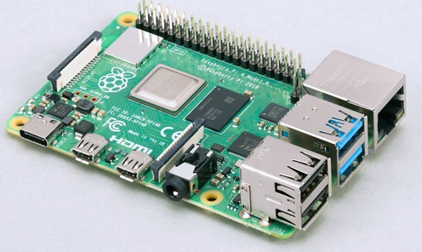
Homework #1
Go to https://www.raspberrypi.org/ → Hardware → All products → Raspberry Pi 4 Model B
Go through the introduction and summarize the information about processor, memory, and I/O.

Slide 3
Homework #1
Broadcom BCM2711, Quad core Cortex-A72 (ARM v8) 64-bit SoC @ 1.5GHz
2GB, 4GB or 8GB LPDDR4-3200 SDRAM (depending on model)
Micro-SD card slot for loading operating system and data storage
2.4 GHz and 5.0 GHz IEEE 802.11ac wireless, Bluetooth 5.0, BLE
Gigabit Ethernet
2 USB 3.0 ports; 2 USB 2.0 ports.
Raspberry Pi standard 40 pin GPIO header (fully backwards compatible with previous boards)
2 × micro-HDMI ports (up to 4kp60 supported)
2-lane MIPI DSI display port
2-lane MIPI CSI camera port
4-pole stereo audio and composite video port
H.265 (4kp60 decode), H264 (1080p60 decode, 1080p30 encode)
OpenGL ES 3.1, Vulkan 1.0
5V DC via USB-C connector (minimum 3A*)
5V DC via GPIO header (minimum 3A*)
Power over Ethernet (PoE) enabled (requires separate PoE HAT)

Slide 4
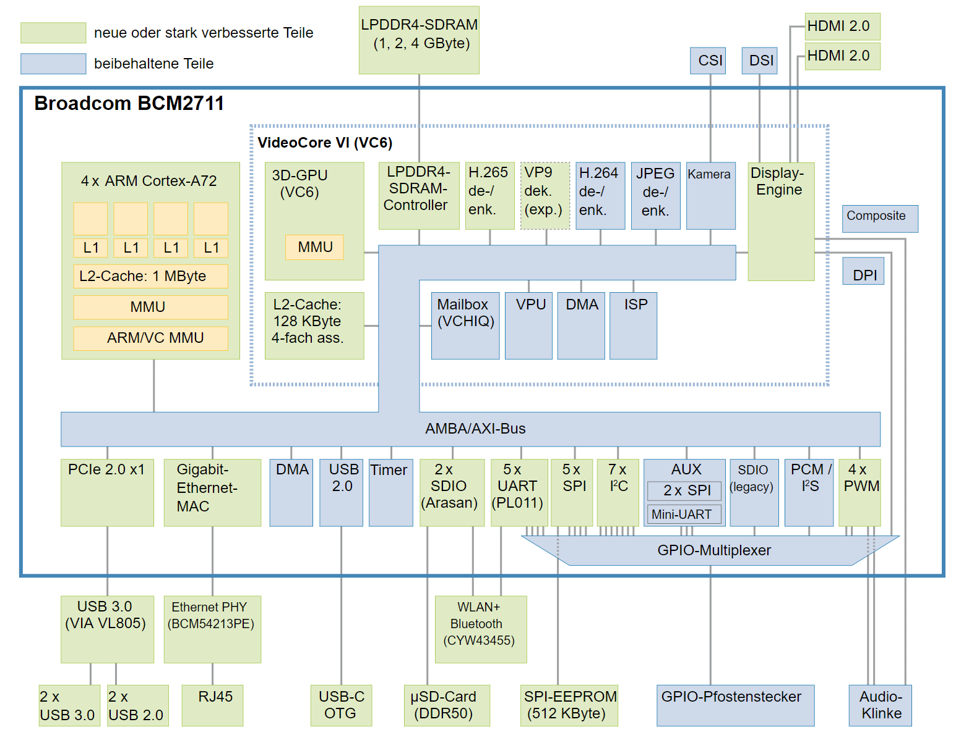
Homework #1

Slide 5
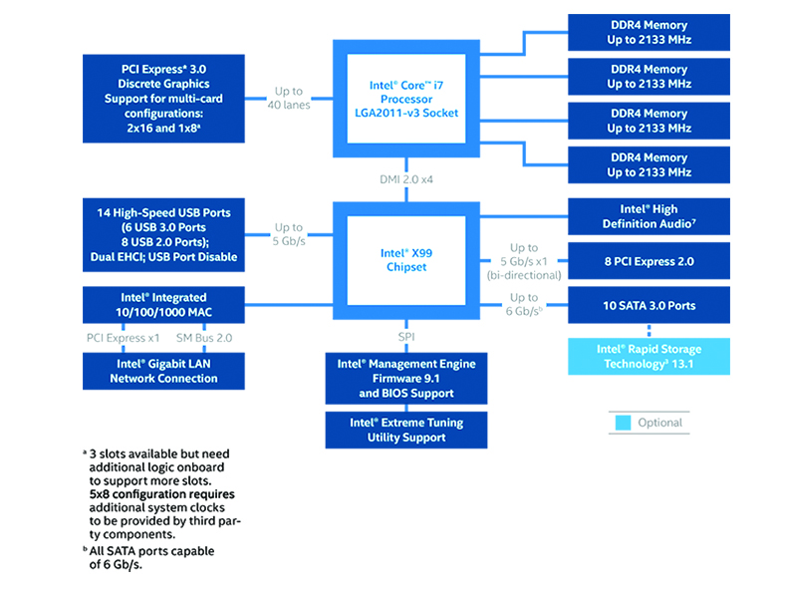
Homework #1

Slide 6
Homework #2
According to the theory of positional numbering system, solve the following problems:
For a decimal number 1325₁₀, get its binary expression.
From the binary expression of 1325₁₀, obtain the equivalent hexadecimal expression.
What is the binary expression of 0.1325₁₀? (Approximate to 4 digits and calculate the error of approximation)
What is the expression of 1325₁₀ for the base of 3?

Slide 7
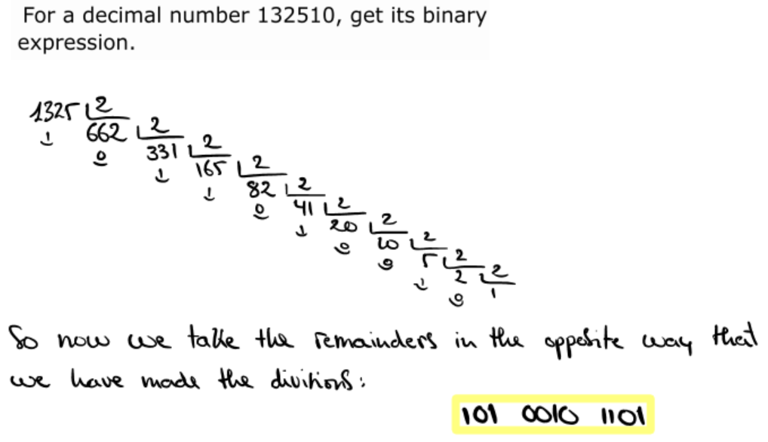
Homework #2
10
HEX:
5
2
D

Slide 8
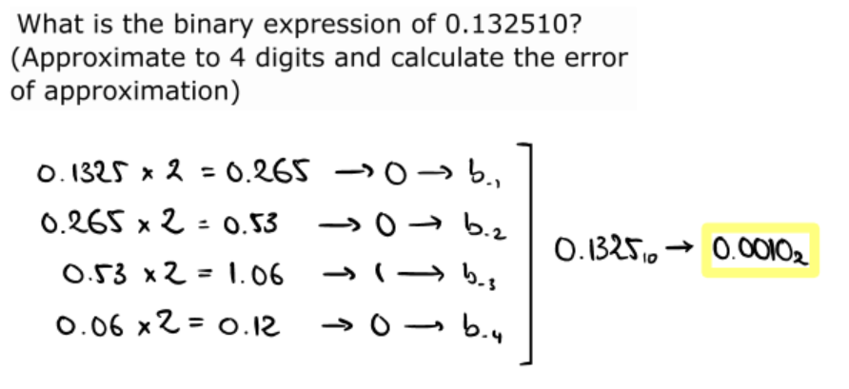
Homework #2
10
12⁻³=0.125
Error: 0.075

Slide 9
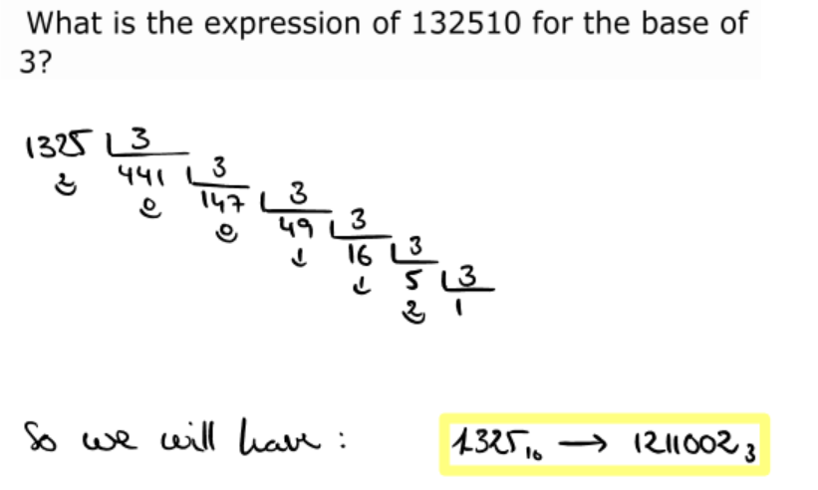
Homework #2

Slide 10
Homework #3
Go to the web page of MARIE simulator (https://marie.js.org/)
(1) Study the instruction set of MARIE (under the ‘Help’ label)
(2) Analyze the ‘Addition’ example and summarize how it works according to the instruction set, memory, and registers
(3) Change the source code to calculate X-Y, and store the result in Z, and output the result. X is the first input and Y is the second input.
Hint: DEC indicates declaration of the variable

Slide 11
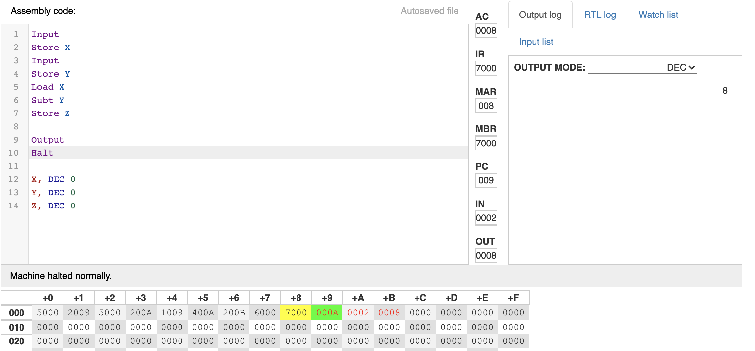
Homework #3
Instruction format: 4-bit opcode + 12-bit address

Slide 12
Homework #4
In embedded systems, UART, SPI, and I²C are three commonly used interfaces to connect the microprocessor and the peripherals.
(1) Read the tutorials for UART, SPI, and I²C and understand how they work.
UART → https://learn.sparkfun.com/tutorials/serial-communication/all
SPI → https://learn.sparkfun.com/tutorials/serial-peripheral-interface-spi/all
I²C → https://learn.sparkfun.com/tutorials/i2c
(2) Summarize the differences among UART, SPI, and I²C.
(3) Explain how SPI and I²C support multiple peripherals.

Slide 13
Homework #4
Commonality:
UART, SPI, I2C are all serial communication interfaces with peripherals
Differences:
UART → asynchronous interface without external signal (same baud rate configuration must be used)
SPI, I2C →synchronous interface with explicit clock signal
UART is used for point-to-point communication
SPI and I2C → supports communication with multiple peripherals in a bus manner. I2C also supports multiple controllers.

Slide 14
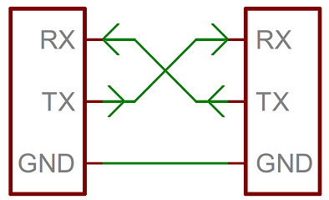
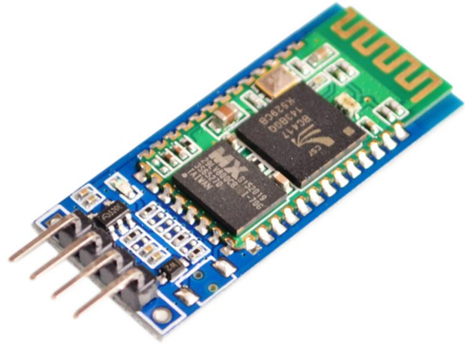
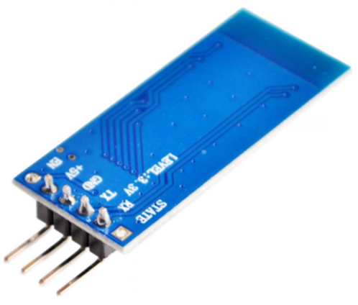
Homework #4
UART
Bluetooth module with UART only

Slide 15
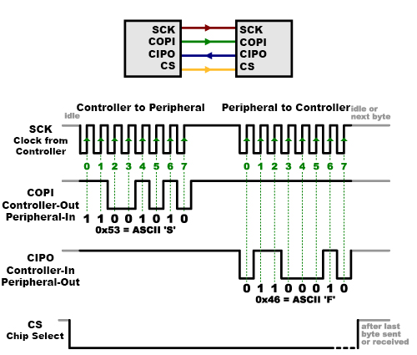
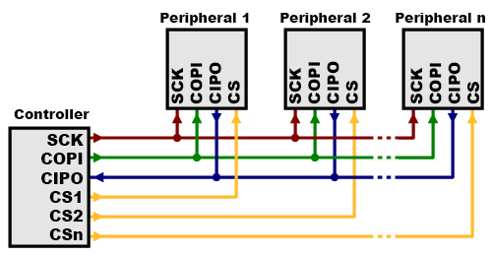
Homework #4
SPI

Slide 16
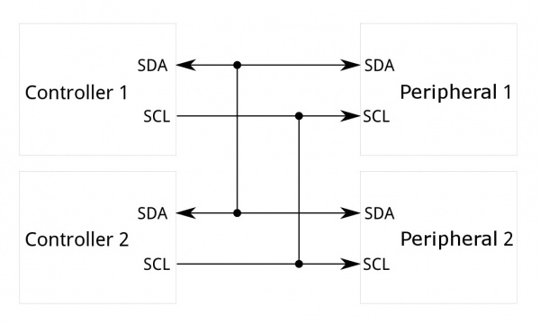
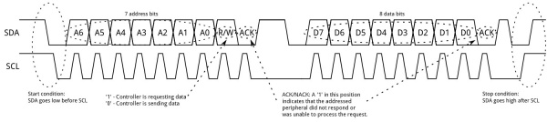
Homework #4
I2C

Slide 17
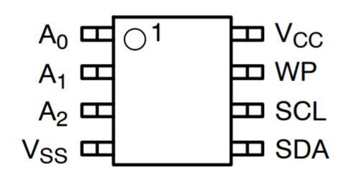
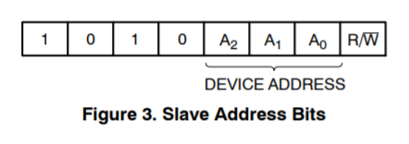
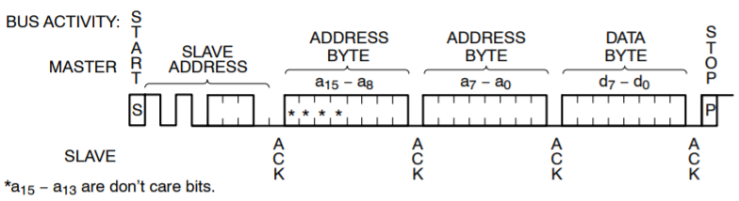
Homework #4
EEPROM with I2C
NV24C64LV
GND

Slide 18
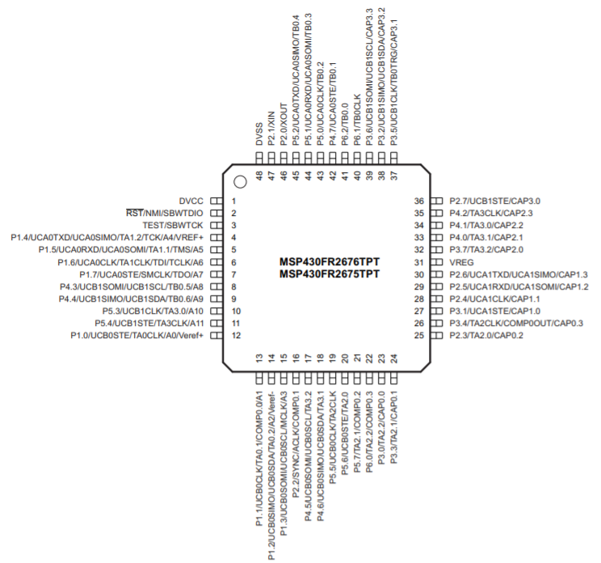
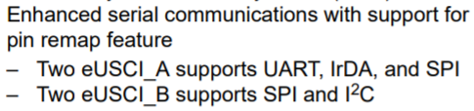
Homework #4
Shared pins among serial communication interfaces

Slide 19
Homework #5
The Raspberry Pi 4 board uses Broadcom BCM2711 as the processor. This processor has 1MB system cache memory.
(1) Assuming you were the designer of this processor, which mapping function (direct mapping, associative mapping, set associative mapping) would you choose?
(2) Explain the reason.

Slide 20
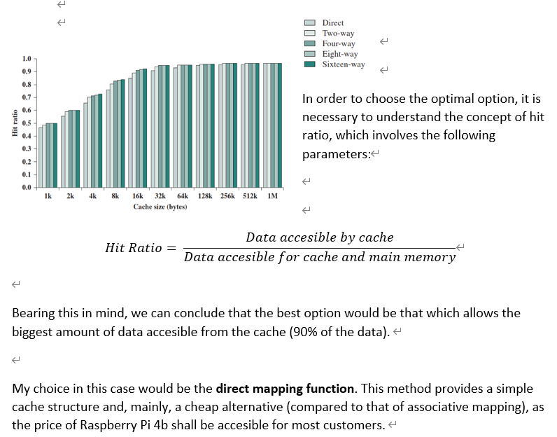
Homework #5

Slide 21
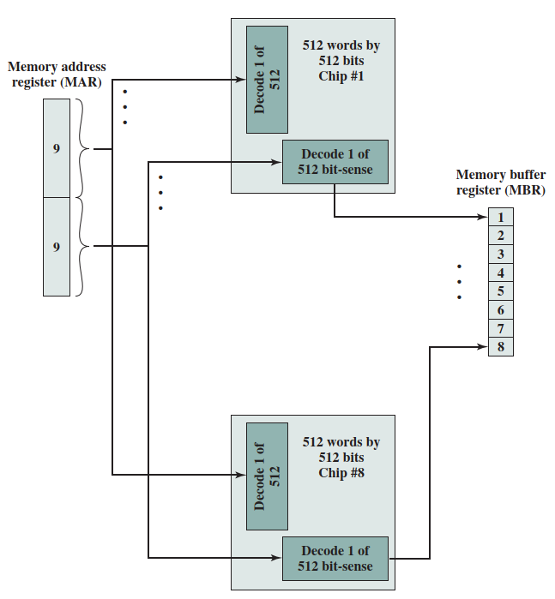
Homework #6
For the following structure, if we change the size of each memory module from 512×512 bits to 1024×1024 bits,
How will the address structure be changed?
For the new implementation with 1024×1024 bits, how to double the memory size without changing the output length?

Slide 22
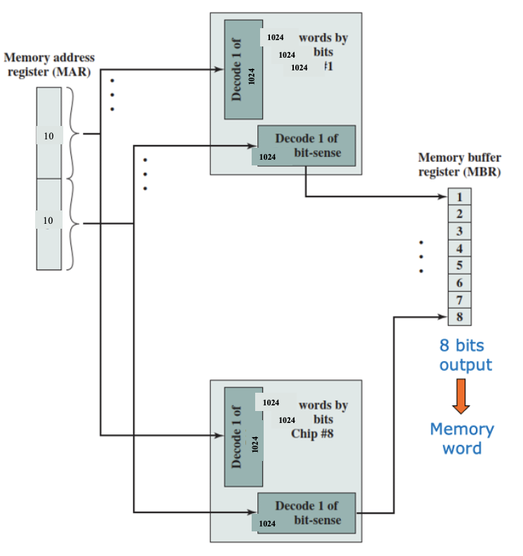
Homework #6

Slide 23
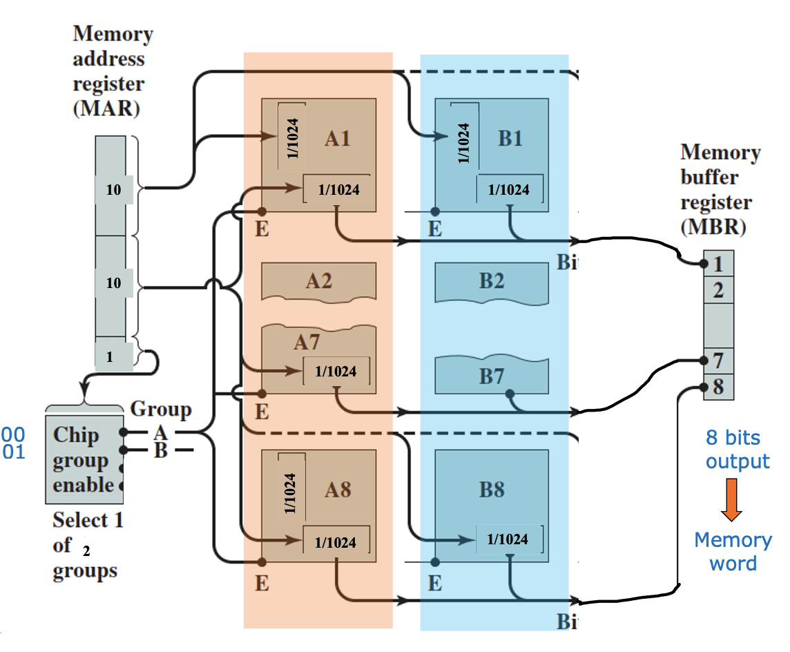
Homework #6

Slide 24
Thank you!

